Slide 1
Web Server Architecture
Web 服务器架构

Slide 2

Linux:
Increase file descriptors `ulimit –n 100000` /etc/security/limits.conf
Optimize TCP/UDP net configurations /etc/sysctl.conf
Log:
Syslog → /etc/rsyslog.conf ← CentOS 7
Logstash + Filebeat
Kafka
Synchrony:
Rsync
git

Slide 3
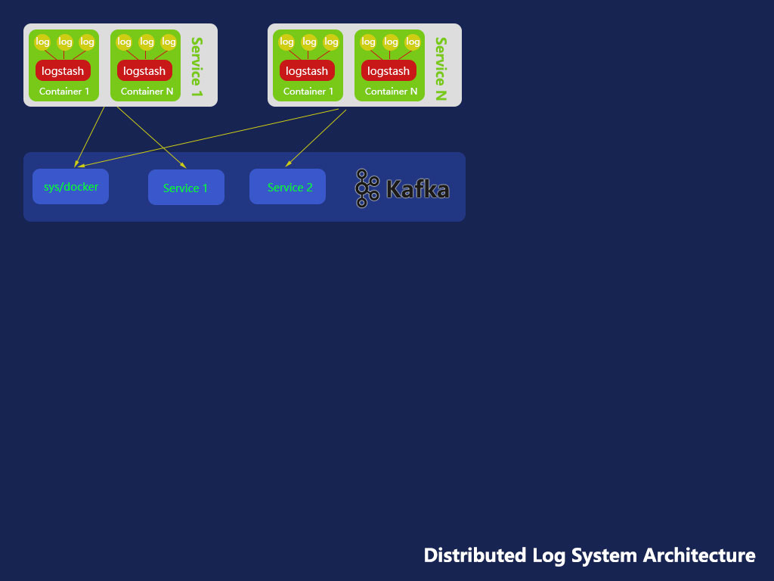

Slide 4
[System]
Dstat
vmstat，
iostat
[load testing]
http_load : runs in single process(won’t bog down the client machine); can do HTTPS fetches.
Apache ab
Fwptt can do Ajax fetches
JCrawler : You can give JCrawler a set of starting URLs and it will begin crawling from that point onwards, going through any URLs it can find on its way and generating load on the web application.
Jmeter :
Web Polygraph HTTP and SOCKS5 proxy support
[php]
Xhprof
[java]
Grinder : testing Java jvm

Slide 5

/etc/sysctl.conf
Increase the memory size of socket buffer
net.ipv4.tcp_mem = 379008 505344 758016
net.ipv4.tcp_wmem = 4096 16384 4194304
net.ipv4.tcp_rmem = 4096 87380 4194304 net.core.wmem_default = 8388608 net.core.rmem_default = 8388608 net.core.rmem_max = 16777216 net.core.wmem_max = 16777216
# Kernel will check the receive time of packets
# Enable this config may cause packet lose through the China mobile’s cmwap.
net.ipv4.tcp_tw_recycle = 1

Slide 6

Optimize php.ini
expose_php = Off
error_reporting = Off
display_errors = Off
log_errors = Off
date.timezone = Asia/Shanghai
; disable Xdebug !!!
; Enable opcache is necessary!
[opcache]
opcache.enable=1
;opcache.enable_cli=0
; [,128+,] : shared memory
opcache.memory_consumption=128
; [,8+,] : interned strings
opcache.interned_strings_buffer=8
; [200, 4000+, 100000] : The maximum number of keys (php scripts) in the OPCache hash table
opcache.max_accelerated_files=4000
; [0,1] : appends Current Work Directory the key, thus eliminating collisions between files with the same basename
opcache.use_cwd=0
; [0,60,] : how often (seconds) to check file timestamps for changes to the shared memory, 0 => always
opcache.revalidate_freq=60
; [0,1] : saves PHP comments in OPcache, suggest not
opcache.save_comments=0
; [0,1] : loads PHP comments from SHM, suggest not
opcache.load_comments=0
; [0,1] : enable fast shutdown sequence
opcache.fast_shutdown=1
; [0,1] : override file existence to performance feature
; it'll use for PHP functions stat() file_exists() ...
opcache.enable_file_override=1
; ~/Notes/Servers/Errors/502 504
; Note: this directive is hardcoded to 0 for the CLI SAPI
max_excution_time = 30
Upgrade to PHP7
Optimize php-fpm.conf
[global]
[www]
# Open Slow Log
slowlog = /var/log/php/php-fpm-$pool.slow
request_slowlog_timeout = 2s
request_terminate_timeout = 10s
# Process Manage
pm = static
pm.max_children = 4 # to the number of the cores of the CPU, then check the idle of the CPU to increase the number

Slide 7

ulimit -n 100000
Swoole uses file descriptor to keep connecting. Set Linux the number of file descriptor to 100000, default is 1024.
Add following configuration to /etc/security/limits.conf
* soft nofile 262140
* hard nofile 262140
root soft nofile 262140
root hard nofile 262140
* soft core unlimited
* hard core unlimited
root soft core unlimited
root hard core unlimited
/etc/sysctl.conf
Increase the memory size of socket buffer
net.ipv4.tcp_mem = 379008 505344 758016
net.ipv4.tcp_wmem = 4096 16384 4194304
net.ipv4.tcp_rmem = 4096 87380 4194304 net.core.wmem_default = 8388608 net.core.rmem_default = 8388608 net.core.rmem_max = 16777216 net.core.wmem_max = 16777216
Max unix socket dgram queue length. You can increase it from 10 to 100, or run more worker process.
net.unix.max_dgram_qlen = 100

Slide 8


Slide 9


Slide 10


Slide 11
Thanks, by Aario

